Slide 1

facinghistory.org

Slide 2
Note to Teachers: Getting Started
This PowerPoint presentation accompanies Lesson 10: Defining Human Rights from the Standing Up for Democracy scheme of work. It is important to read the lesson plan in order to understand its rationale, the historical context, and information in the Notes to Teachers section about creating a UDHR mini-lecture.
This presentation includes verbal instructions for the activities in the Notes beneath each slide. Accessing hyperlinks in PowerPoint involves extra steps: select View - Notes Page - right click on the hyperlink - and select Open Hyperlink. Alternatively, you can access the hyperlinks from Lesson 10: Defining Human Rights or by viewing the presentation in Google Slides.
While you may need to modify this presentation to meet the needs of your students, please note that Facing History and Ourselves is not accountable for any changes that alter the presentation's content or original layout.
Notes:
Information about Standing Up for Democracy PowerPoint Slides
Each PowerPoint accompanies a corresponding lesson plan that includes more detailed instructions about the activities and should be read in advance of teaching the lesson.
Wherever possible, we have used images in lieu of writing to encourage the verbal delivery of instructions as a means of boosting focus and to promote active listening skills.
The same image is used for each recurring teaching strategy throughout the scheme of work to facilitate recall and promote student independence.

Slide 3
Defining Human Rights

Slide 4
Guiding Question
How did the international community decide upon a universal set of human rights?
Notes:
Defining Human Rights: Learning Objectives
To create a working definition for “a right” and then compare and contrast it to UNESCO’s 1947 definition.
To record information about Eleanor Roosevelt’s inspiration behind, and role in, the creation of the Universal Declaration of Human Rights.
To identify three universal human rights and explain their importance.

Slide 5


What is a right?
What rights do you have in your home?
What rights do you have at your school?
What rights do you have in your community?
What rights do you think you should have in your home, school, or community but don’t feel that you do?
Notes:
For this journal entry, students will respond to a series of questions about their rights.
Reveal the questions one at a time so students have a chance to think and write about each one before seeing the next question.
After they have answered all five questions in writing, ask students to debrief in a Think, Pair, Share, adding ideas to their “What is a right?” response if they agree with something their partner wrote that they didn’t think about at the time.

Slide 6
A right is . . .
Notes:
Ask students to work with their partner to create a “working definition” for right and share it with another pair of students or with the class. (See Notes to Teachers for an explanation of working definition).

Slide 7

United Nations Economic and Social Committee (UNESCO)
The Definition of Right:
. . . condition of living, without which. . . men cannot give the best of themselves as active members of the community because they are deprived of the means to fulfill themselves as human beings.
Notes:
Project the following definition of right and explain to students that the United Nations Economic and Social Committee (UNESCO), a United Nations agency, was founded in 1946 to advance “. . . peace and security by promoting collaboration among the nations through education, science, and culture in order to further universal respect for justice, for the rule of law and for human rights and fundamental freedoms.” In 1947, UNESCO defined a right as: . . . condition of living, without which. . . men cannot give the best of themselves as active members of the community because they are deprived of the means to fulfill themselves as human beings.

Slide 8

Notes:
Ask students to work in small groups to answer the questions (next slide) about the UNESCO definition of a right.

Slide 9

In what ways is the UNESCO definition similar to and different from your working definition of right?
Do you think the UNESCO definition is too broad, too narrow, or just right?
If the United Nations asked your group to provide them with feedback about UNESCO’s definition of a right, what would you suggest?
What are three rights that you group unanimously believes are “universal” - that apply to all people from every cultural and political background?
Why are these rights important to everyone regardless of age, gender, geography, history, politics, religion, etc.?
Unanimously: supported by everyone in the group / everyone agrees
Notes:
Project and/or pass out the discussion questions to groups.
Have students take notes on their discussion. They will need their answers to questions 4-5 for the next lesson, Lesson 11: Making Rights Universal.

Slide 10

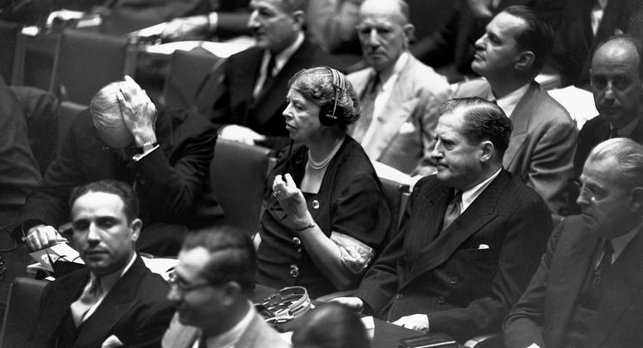
3 - Details about what inspired Eleanor Roosevelt’s work
2 - Challenges UN members faced when writing the UDHR
1 - Question about the UDHR or the process of creating it
Notes:
Tell students that they will now watch a video to learn about the process by which the Universal Declaration of Human Rights was drafted by representatives of nine countries in the United Nations, who also grappled with the question of what is a right and what rights should belong to every human being on earth.
Have students take out their journals for the 3-2-1 response.
Play the video Fundamental Freedoms: Eleanor Roosevelt, the Holocaust, and the Universal Declaration of Human Rights (09:15).
Pause the video 2–3 times so students can capture what they learned in a 3-2-1 response in their journals without missing any of the images that help tell the story of the historical events leading to the creation of the UDHR.

Slide 11

Notes:
Debrief the video by completing three wraparounds.
For each round, have students share a phrase from their 3-2-1 responses, starting with their ideas about what inspired Eleanor Roosevelt’s work in round one.

Slide 12

Who is responsible for protecting people’s fundamental rights?
What responsibility do individuals have to ensure that everyone’s rights are protected? What makes you say that?
What responsibility do governments have to ensure that everyone’s rights are protected? What makes you say that?
Who should be included in a country’s universe of obligation? Anyone in the country at a given time? Residents of the country? Citizens of the country?
Notes:
Ask students to respond to the questions on an exit card that they will submit at the end of the lesson.
Let them know that they will be revisiting these ideas in the next lesson, which focuses on the Universal Declaration of Human Rights.

Slide 13





@facinghistory | facinghistory.org

